Slide 1


Go Tickets (Ticketing portal)
System Proposal & details
-by Moumi Kumar, Miloni Gada, Monisha Gopal and Kalyani A

Slide 2

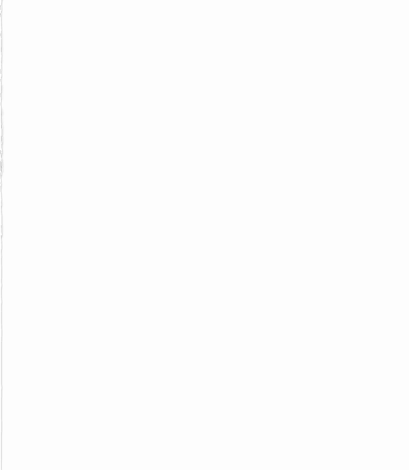
Index
Business proposal and requirement
System Request
Context diagram
Use Cases
User Interface
Conclusion

Slide 3
Problem Statement
Year after the lockdown has affected and influenced the way of living for all the people in United States , There was a trend that followed .
The study found that digital ticket purchases increased by 18.7% in 2018, while tickets purchased at the event venues and box office decreased by 5.4%.
In these fast-paced overly competitive times, we are gradually shifting to a digital age. We read the news online, we shop online, we order food online and so on. But why stop there? Why not extend this to other sectors too?
Go Tickets is one such online platform that enables the users to view listing of events/shows online, based on their location, the type of show they’re interested in, duration of the event etc.

Slide 4
Go Tickets helps the users to choose amongst an array of events happening around them, book tickets for the same in advance, get discounts and get an overall simplified user experience.
But we don’t stop there. ..Along with the customers, we have other end users too – they are our event partners.
From a local event like a stand-up comedy show to multi-national events like music concerts, every event deserves awareness and recognition.
In order to make sure that the local art doesn’t get lost in the pool of competition, our website showcases them on the dashboard to catch user’s attention.
To sum it up, we make event/show listing and booking more comprehensive and user-friendly.
Business Requirement & Proposal

Slide 5
Scope of the system
Go Tickets has two primary users:
Customer:
Our system enables them to view events/shows online and book tickets for the same.
The customer can additionally order food/beverages online along with the event ticket booking.
Customers can also provide feedback for the events they view and we offer discounts to our regular customers.
Event partner:
Our system enables them to list their events/ shows along with the description onto our page.
They are charged annually for the subscription they prefer and provided by user feedback for their events.

Slide 6
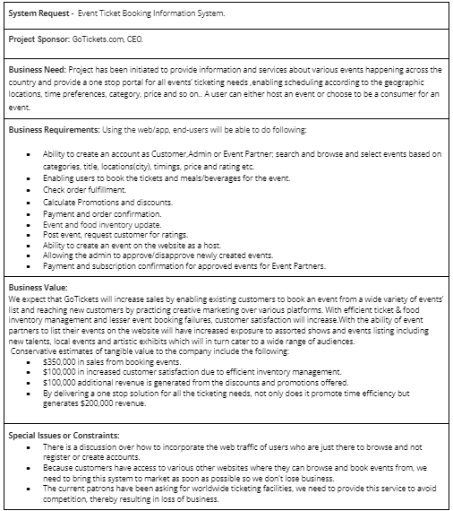
System Request

Slide 7
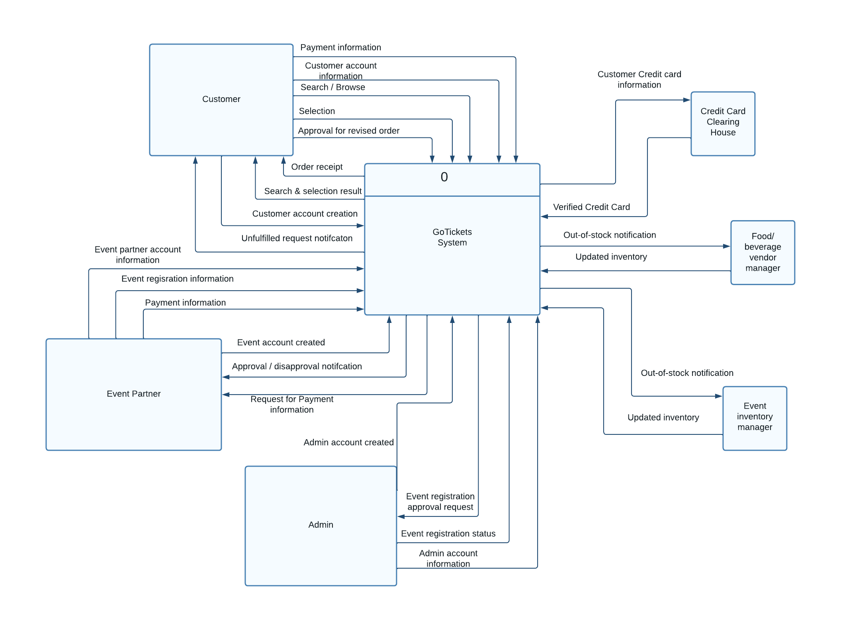
Context Diagram

Slide 8
Use Cases
UC1
Create Account , Search ,Browse and select:
The user is allowed to create their own accounts on the website based on their role.
The list of events is displayed on the website to the customer by extracting information from the event data store
The system will allow the customers to browse and search from the event list based on venue, price, details, images and descriptions
The system will allow the user to select one show/event at a time from the dashboard based on place, time, language of the movie, genre and format (2D,3D, IMAX2D).

Slide 9
Use Cases
UC1 (contd).
The system will allow the user to select one or more seat preferences from the seating arrangements.
The system will allow the user to select one or more items from the “food & beverages” menu for pre-booking meals

Slide 10
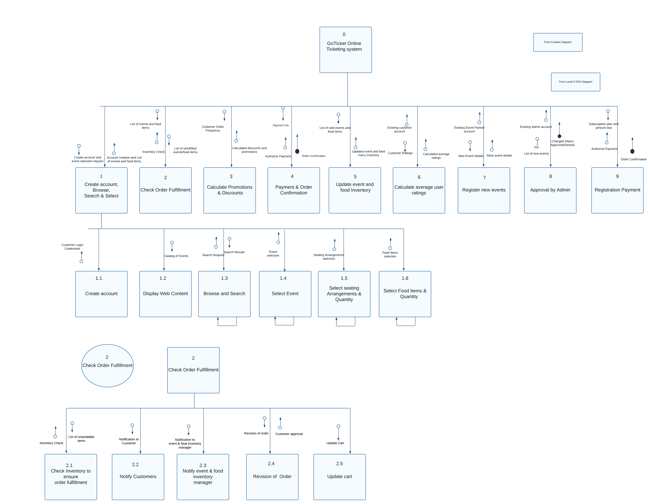
Program Structure
Structure Chart

Slide 11
Use Cases
UC4
Payment and Order Confirmation(system)
The System will :
Calculate the cart amount for the user selection.
Calculate tax based on the city (where the event is based) referring to the tax data store.
Calculate the total order amount based on the tax, promotions (discounts) and cart value.
Request the user to provide their credit card details in the payment gateway.
Route these details to the Credit Card Clearing House for verification
Upon verification and payment confirmation, the system generates an order receipt for the customer.

Slide 12
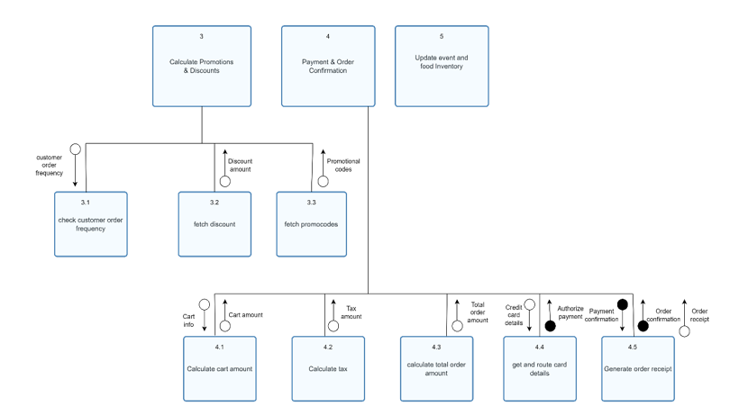
Program Structure

Slide 13
Use Cases
UC7
Event posting (user)
The System will :
The system will allow the event partner to login and access their account.
The system will ask the event partner to fill up a form with their event information like event name, event region, event city, event type, expected audience, event date and event short description.
Once approved/disapproved, the system will notify the respective event partners about the status of the event registration request

Slide 14
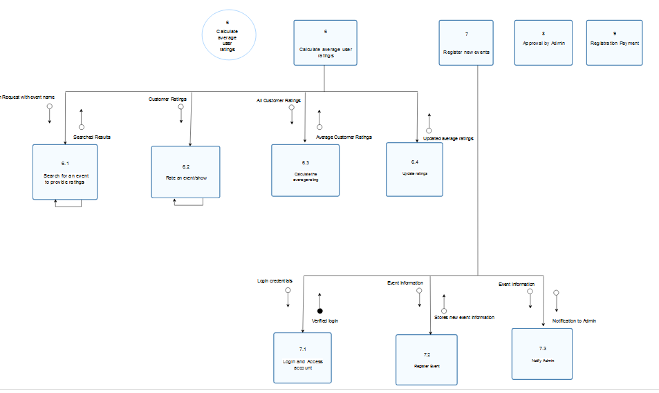
Program Structure

Slide 15
Use Cases
UC8
Admin Approval
The System will :
Allow the admin to login and access their account.
Show all the pending requests waiting for approval.
Update the events data store and add the event details to it.
Send a notification to the event partner regarding event registration status.

Slide 16
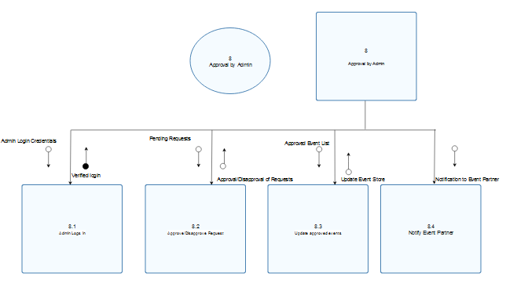
Program Structure

Slide 17
UI Design Templates

Slide 18
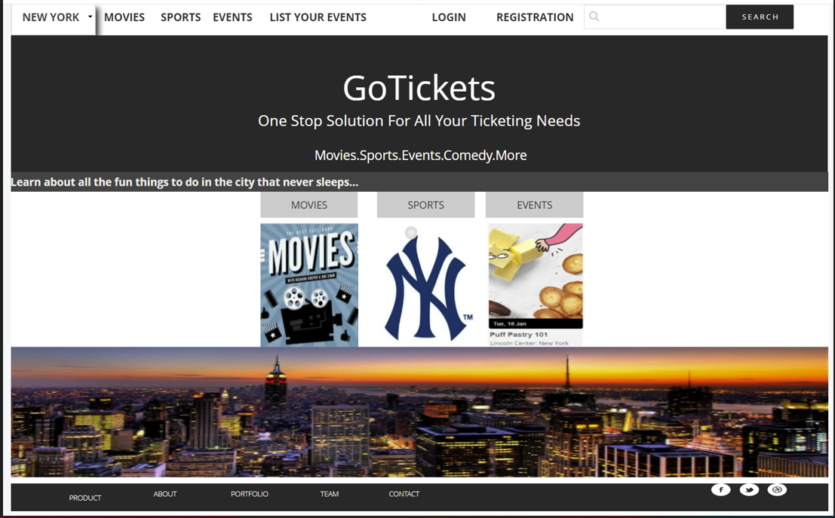
Home Page

Slide 19
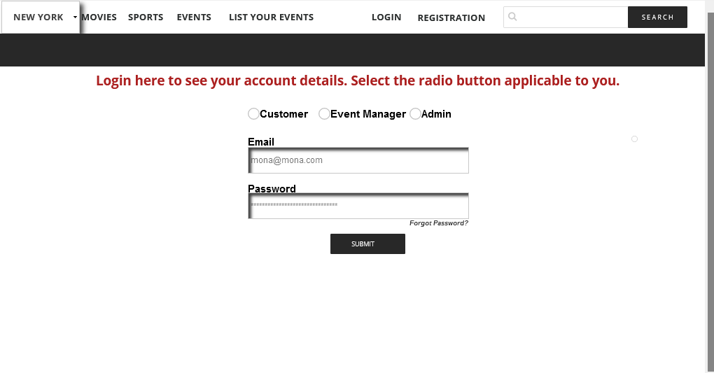
Sign In Page

Slide 20
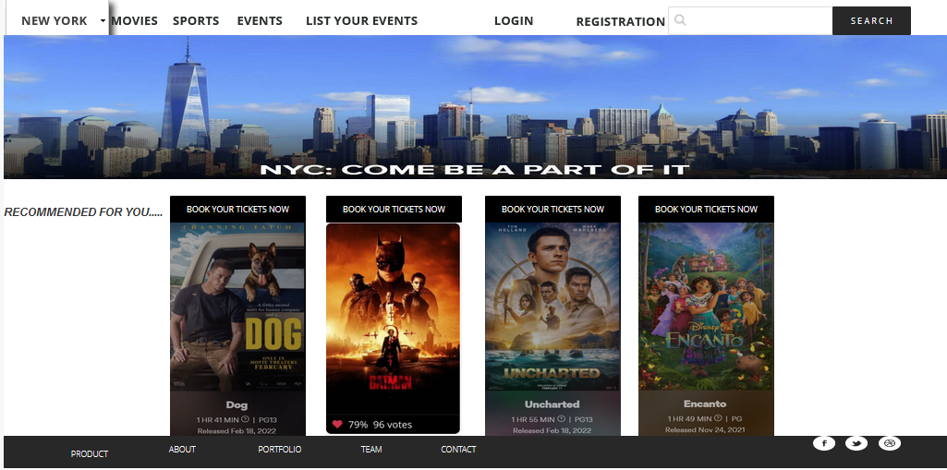
Movie Booking Page

Slide 21
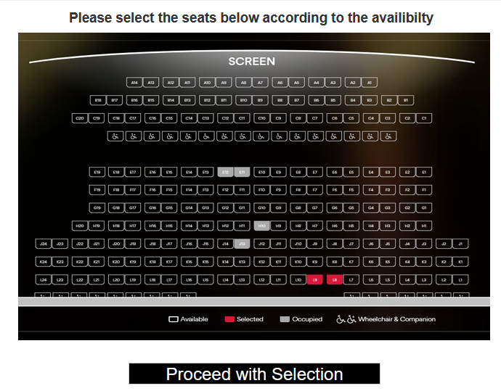
Seat Selection Page

Slide 22
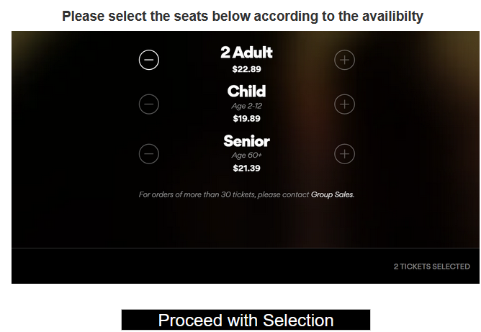
Ticket quantity selection

Slide 23
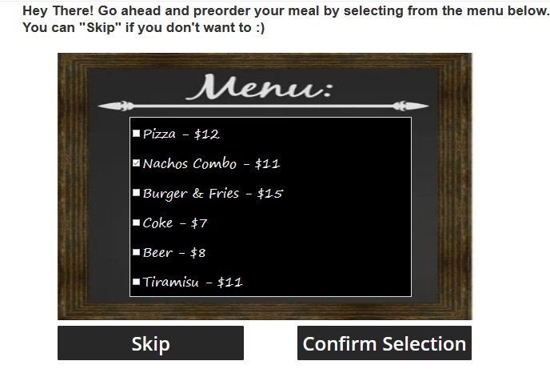
Preorder Meals

Slide 24
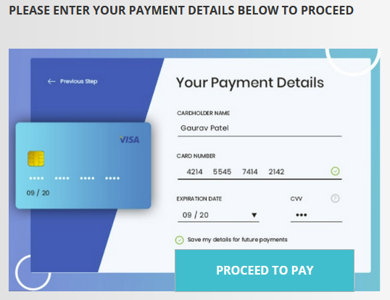
Payment details page

Slide 25
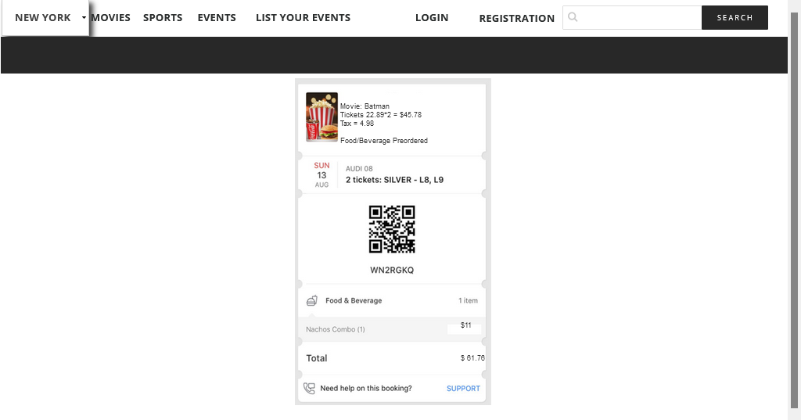
Order confirmation and receipt

Slide 26
Sign In Page

Slide 27
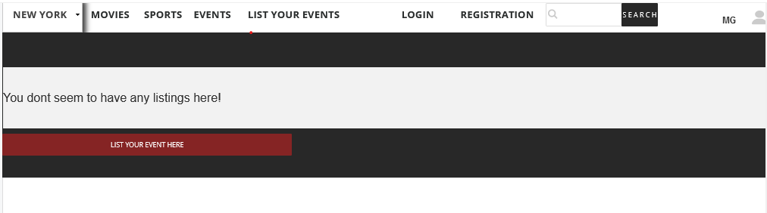
Event Partner Landing Page

Slide 28
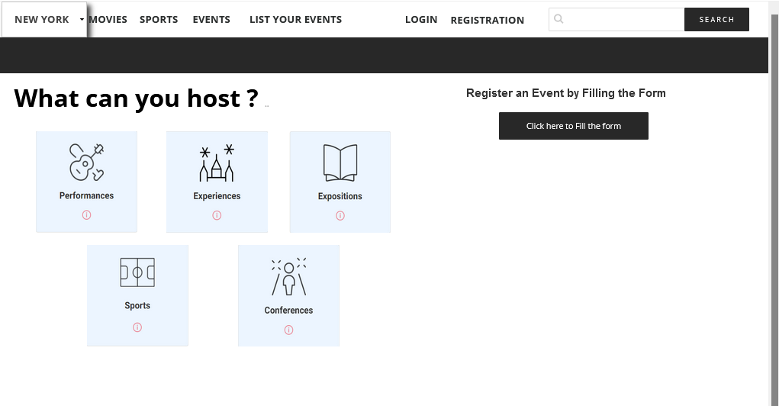
Event Listing Page

Slide 29
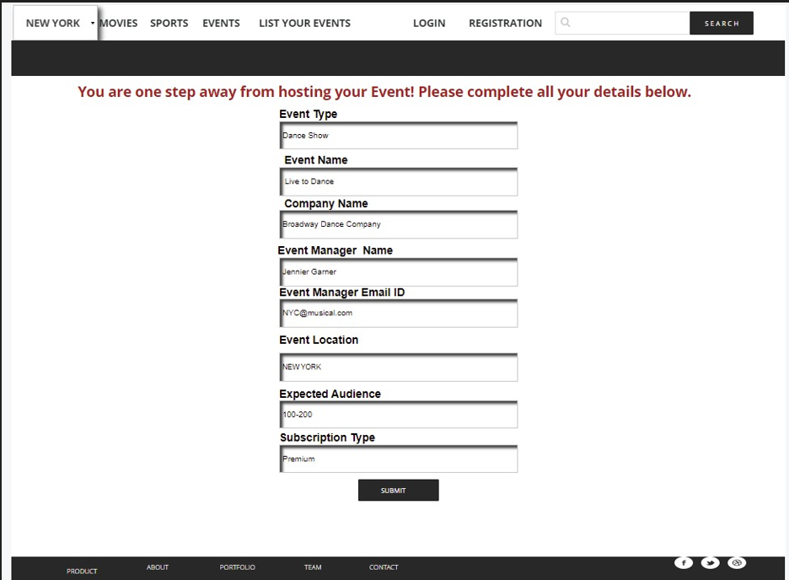
Register An Event page

Slide 30
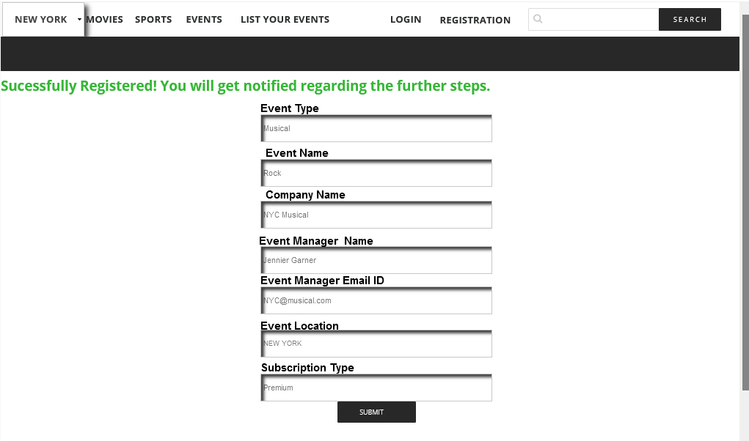
Event registered successfully

Slide 31
Sign In Page

Slide 32
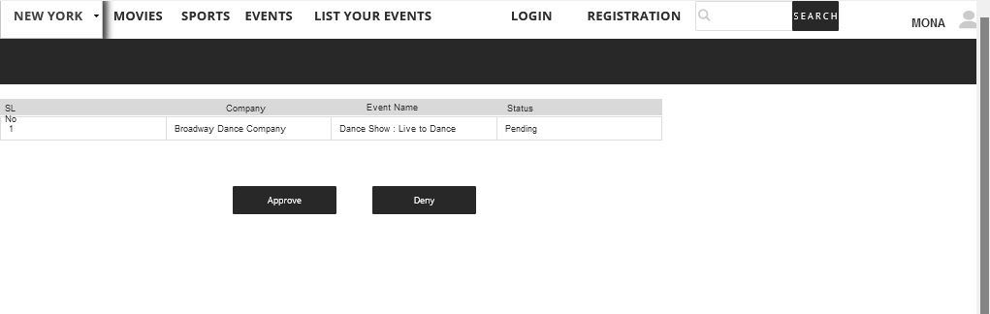
Admin landing page

Slide 33
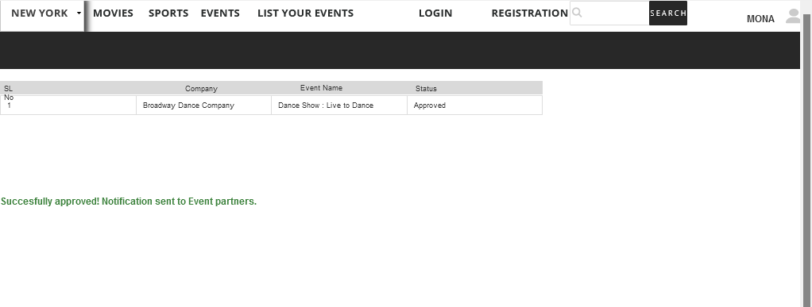
Admin events approval page

Slide 34
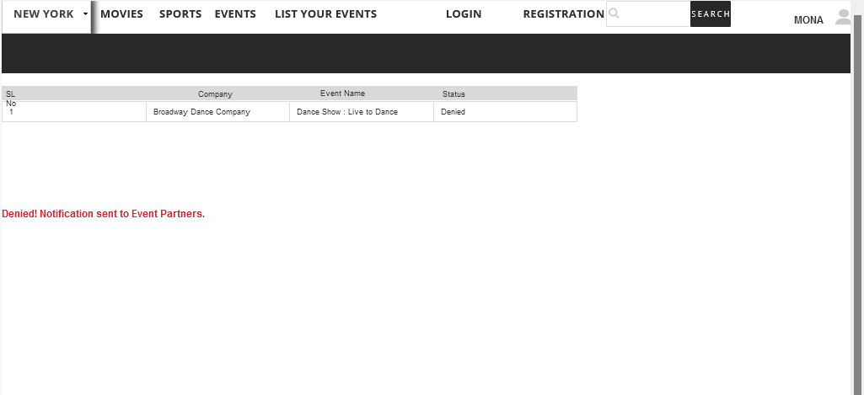
Admin events denied page

Slide 35
Future Scope
We would like to add few points to explain future scope :-
The traffic from users who just want to browse through the website and not buy tickets to any event could be managed better.
If in future we are able to apply Machine learning to predict a user’s preferences , we could customize the event page for each user after they log into the system. This would in turn result in strengthening one to one connection with the brand.
In order to prevent customers from unsubscribing, we can build automated campaigns for different user segments based on their order history.

Slide 36
Conclusion
We have built our project based on the core principles of system analysis and design. Using problem-solving strategy, that includes glimpsing at the more extensive system, we were able to break our project into different parts based on different players and sorting out how they work to accomplish a single objective.
The crux of effectively building a system with the right organization of data is to understand how different players view it.
It can be done if requirements are defined in terms of a clear understanding of the inherent structure of the enterprise's data.
So, in conclusion, we can say that system analysis involves significant stages in the growth of any system by detailing the requirements that satisfy present requirements along with alterations in the future.

